Slide 1
Amusement Park Simulation
Lauren Alley, Lauren Slade, Anthony Khoudari, Josh Linneburg

Slide 2
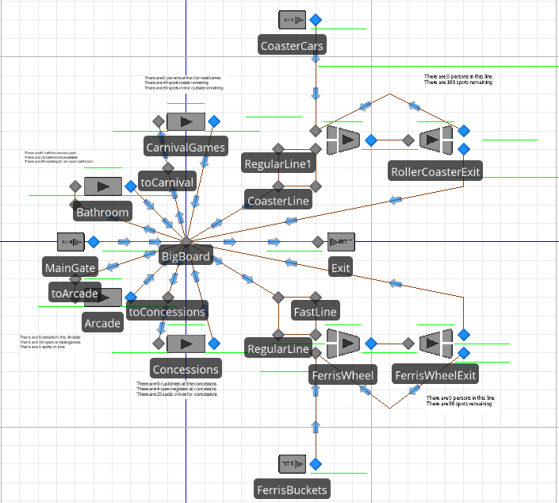
Overview of the Park
Notes:
Anthony

Slide 3
Regular Pass Holder
Fast Pass Holder
Ferris Wheel Bucket
Roller Coaster Cars
Entity Key
Notes:
Anthony

Slide 4
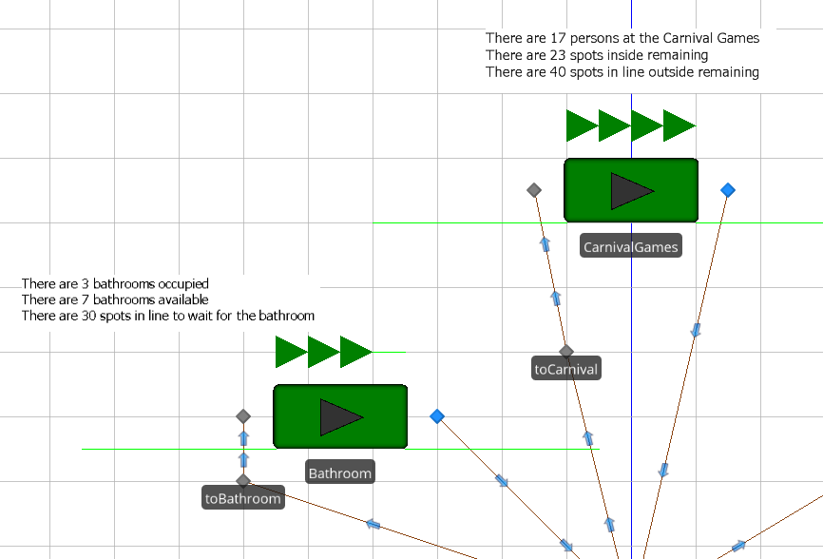
Dynamic Labels
- Used to track the real time statistics of each area within the park
- Gives us an updated snapshot of where entities are, and where they might go
Notes:
Lauren A

Slide 5
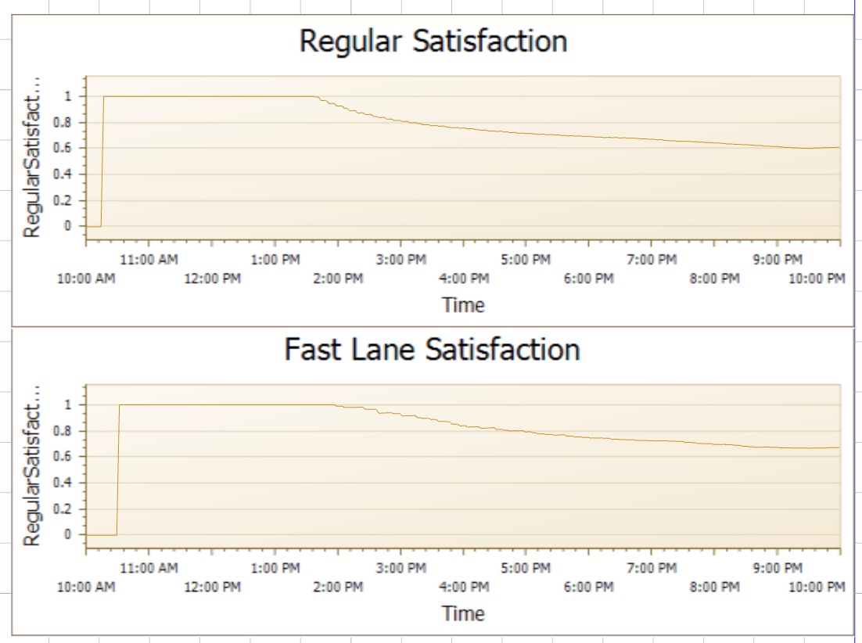
Dynamic Graphs
- Used for more quick, at-a-glance analysis of the model
- Gives an idea for how incremental changes might impact satisfaction
Notes:
Lauren A

Slide 6
How It Works

Slide 7
Model Assumptions
Rollercoaster load times are a constant 9 minutes; this deviates from the triangularly-distributed load time in the problem
Both rollercoaster cars can be on the track at the same time
A car can be sent partially full, at least one customer must be in it
Half the ferris wheel is loaded (and then unloaded) every five minutes, halfway through the ride
Fast Pass customers do not have absolute line priority over Regular customers, only in most cases
Notes:
Lauren A (2.5ish mins for slide 4-7) Point 1: We were unable to assign a waiting time to an entity once they were assigned to a parent in either of the combiners. As such, we are measuring the time the entity joins the MemberInputBuffer and the time they get off the ride. Since the load, unload and ride times are all constants, we can reach the time the entity spent in the line.
Point 2: The coaster car source sends two entities to the combiner at the start of the simulation and, like in real-life, both can be on the tracks at the same time. This cuts down on customer waiting times.
Point 3: A train may have anywhere between 1 and 10 customers in it, but it must have at least 1 customer to be sent on the tracks.
Point 4: 15 buckets are sent with 2 customers each. They reach the halfway point where they pause for the other 15 buckets to load their 2 customers each. Both continue on until reaching the separator and halfway point, respectively, where the process starts again. This cuts down on waiting time because instead of the entire ferris wheel completing one cycle every 10 minutes, half of the ferris wheel completes a cycle every 5 minutes. Previously, we had any Fast Pass customer in line for the ferris wheel leave unsatisfied due to the processing time of the single ferris wheel, without any halfway point exchange. Customers always had to wait around 10 minutes for the ferris wheel, no matter if they were Fast Pass or not.
Point 5: We will discuss this more on the next slide.

Slide 8
Big Board Decision
First checks if a customer has exceeded their desired length of stay
If they have not, assigns 6 “viable” Model Entity states a value of 1 or 0 based on availability, customer type, if they’ve visited that area, etc.
If there is at least one viable option, the customer receives a randomly-generated “NextStop”
If there are no viable options, the customer is delayed a minute and the process repeats itself
All viable options are equally likely
Notes:
3.5 minutes for Slides 8 and 9
Josh
6 “viable” Model Entity states are in the form CoasterViable, FerrisViable, CarnivalViable, etc. and are assigned a 1 if that is a viable option based on the line, if they customer has an interest in going there, how many times they’ve been there, etc. accoridng to the problem. If they fail to meet all criteria to be a viable choice, they are assigned 0.
The sum of the six “viable” states gets us the “NumberViable”, or the total number of viable options.
Some clever math in the form of “Destination n Viable * (Destination n Viable + ∑Previous n-1 Destinations Viable)/NumberViable” allows us to use the Random.Discrete distribution in Simio.
If Destination n isn’t viable, the probability of getting that number is 0 because of the first term. If it is viable, the cumulative probability of getting <= that number is the sum of the previous viable variables divided by the total number viable.
According to the problem, all viable options are equally likely as the next path. We were able to modify our logic beyond simply going to the first destination that was viable in a sequential list; our entities move randomly throughout the park as long as there is at least one viable option.

Slide 9
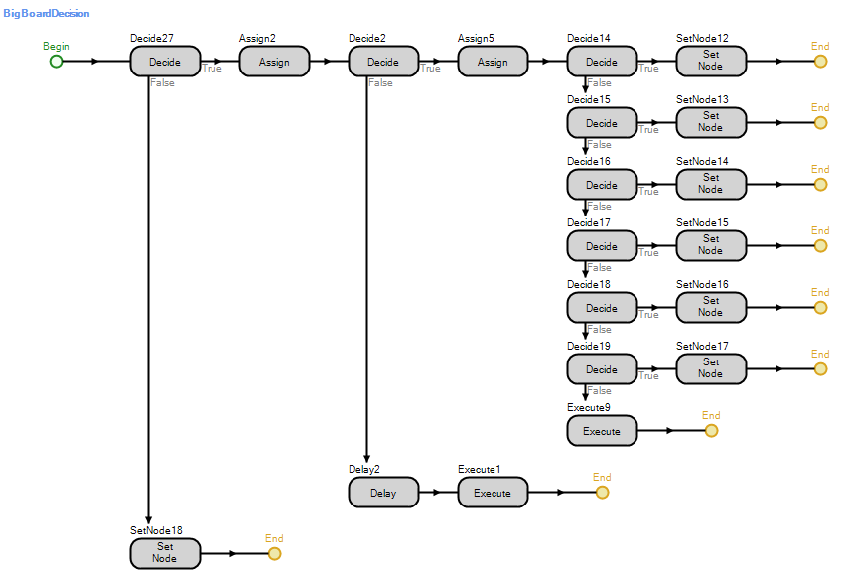
Big Board Decision
Notes:
Josh

Slide 10
Solving the Problem
What proportion of Fast Passes would you recommend to maximize satisfaction?

Slide 11
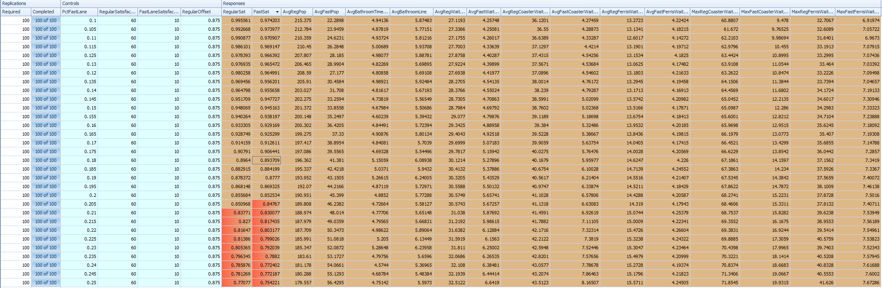
What is the best customer mix?
Notes:
●Have the following response variables
1.Satisfaction Rates
2.Avg Fast pass and Regular customer in the park
3.Avg wait time overall, the Avg wait time for coaster and Ferris wheel separately
4.Max wait time for coaster and ferriss wheel

Slide 12
What is the best customer mix?
Assumed the desired satisfaction for both Regular and Fast was >= 90%
25% Fast Pass results in Satisfaction in the mid-70% range
Lower than ~11% Fast Pass results in Satisfaction in the 99% range
Would recommend no higher than 17.5% based on our simulation results
If comfortable with less satisfaction (~85%)...
20% Fast Pass yields an 85% Satisfaction rating
23% Fast Pass came back with roughly 80% Satisfaction
Notes:
Lauren S
●Benchmark Customer satisfaction for both Regular and Fast past be Greater than or equal to 90%
●Tested different fast pass proportions with the ranges of 10%-25%
25% yields a satisfaction rate in the mid 70% range
Lower than 11% Fast pass results in Satisfaction in the 99% range
●In order to meet the benchmark of satisfaction being >= 90% we’d suggest the percentage of fast pass customer be 17.5% and 82.5%
●If the manager is comfortable with less satisfaction then the manager can explore higher proportions
20 % gives an 85% satifsfaction
23% comes back with around 83% satisfaction

Slide 13
Suggested Solution Results
If 17.5% of Customers were Fast Pass customers, then...
Average Regular/Fast Pass in the park: 197 / 39.5
Average Bathroom Wait Time/Line Length: 4.6 min / 5.5 customers
Average Regular/Fast Pass wait at any ride: 29.7 min / 5.1 min
Average Regular/Fast Pass wait at the Coaster: 40.2 min / 5.75 min
Average Regular/Fast Pass wait at the Ferris Wheel: 14 min / 4.2 min
Notes:
Lauren S
Average Regular 197 people and average fast pass 39.5
●With the 17.5% Fast pass customer’s we were able to keep the regular customers avg waiting time below 60 minutes and the Fast pass customers wait for the rides combined between the 5-10 minutes benchmark
Avg bathroom wait time, down from 9 minutes to 4.6 minutes and 5.5 customers waiting on average
●For any rides the avg wait time, 29.7 minutes for regular and 5.1 min for Fast pass
Avg wait time on the coaster 40.2 regular and 5.75 for fast pass
●For the the Ferris Wheel we were able to get the average waiting time down to 4.2 minutes for the fast pass customers. That is below what they are normally use to waiting

Slide 14
Suggested Solution Results
Max Regular/Fast Pass wait at the Coaster: 66 min / 13.8 min
Max Regular/Fast Pass wait at the Ferris Wheel: 36.04 min / 7.2 min
Satisfaction decreases at an increasing rate, starting from 10% Fast Pass through 25% (the highest we tested)
17.5% strikes a good balance at the cost of some Satisfaction
Management should also look at how “powerful” the Fast Pass is in terms of line priority; able to tune in the Experiments window
Notes:
Anthony

Slide 15
DEMO
Notes:
Takes around 3 mins

Slide 16
Q & A
Notes:
3 mins

Slide 17
Fast Pass Priority
When an entity enters the queue and we take note of the time they entered, we also give them a “LinePriority” Model Entity State
The combiner takes the smallest value first, a proxy for a First-In-First-Out queue, but Regular customers are given an extra offset to keep them behind Fast Pass customers, to a certain point
A Fast Pass customer has priority over a Regular customer if they both entered the queue at the same time (or if the Regular customer entered < 52.5 minutes before the Fast Pass customer)
A Regular customer has priority over a just-entered Fast Pass customer if the Regular customer entered the queue > 52.5 minutes ago
Notes:
Example: A Regular customer enters the line for the coaster at 12 noon. They are assigned a LinePriority of 2.875 (because it has been 2 hours since the start of the simulation, plus our offset).
It is now an hour later, and the Regular customer is still in line.
A Fast Pass customer enters the line. They are assigned a LinePriority of 3 (because it has been 3 hours since the start of the simulation, and there is no offset for Fast Pass customers).
Because the Regular customer has a smaller LinePriority number, they will have priority over this Fast Pass customer. The Fast Pass customer gets in line behind this Regular customer and any Regular customers who have a LinePriority less than 3.
This allows us to have a mixture between a First-In-First-Out and priority-based queue. Fast Pass customers break this FIFO approach, but only to a certain point under this system.
Essentially, a Regular customer only gains priority over a Fast Pass customer that just entered the line, if they have been waiting for at least .875 hours (52.5 minutes).
We did this because,
1) This is closer to how Fast Passs work in real-life, they are not usually an absolute line bypass mechanism,
2) This helped ease the flow of traffic in our lines, boost some Regular customer satisfaction without hurting Fast Pass customers too much, and
3) Because we think management should not only look at the proportion of Fast Pass customers, but how powerful the Fast Pass is relative to Regular customers, they are now able to tweak this in the model because the offset is a Model Property.

Slide 18
Big Board Decision
Example: A customer returns to the Big Board and all options evaluate to “1”, viable, except the rollercoaster (Option 1) and the bathroom (Option 6)
The customer then has a
0 * 0/4 cumulative probability to get <= 1, the rollercoaster
1 * (0 + 1)/4 cumulative probability to get <= 2, the ferris wheel
1 * (0 + 1 + 1)/4 cumulative probability to get <= 3, the carnival
1 * (0 + 1 + 1 + 1)/4 cumulative probability to get <= 4, the arcade
1 * (0 + 1 + 1 + 1 + 1)/4 cumulative probability to get <= 5, the concessions
0 * (0 + 1 + 1 + 1 + 1 + 0)/4 cumulative probability* to get <= 6, the bathroom
The customer is sent to whichever one of the four viable choices are selected
Notes:
* since the previous line evaluates to 4/4, or 1, this statement is not evaluated by the Simio Random.Discrete function.
The Simio Random.Discrete function stops evaluating when the last option has a cumulative probability of 1.
It will not take in a final parameter if the P(X <= x) <> 1. This is why we can “get away” with saying the P(X <= 6) = 0… because Simio does not evaluate this option.
Through this methodology, our “die” that we roll each time the customer returns to the Big Board dynamically changes the number of sides it has based on the number of viable choices. Previously, we randomly picked a number between 1 and 6, and then evaluated if it was a viable choice. If it wasn’t, entities waited a minute and then “rolled” again. This resulted in some entities waiting at the Big Board for far too long when there was only 1 or 2 viable options; they’d have to roll 3 or 4 times before the probability of rolling that single open option exceeded the probability of not.
------------------------------------------------------------------------------------------------
Math example (don’t plan to use in class but for everyone else’s benefit):
Imagine a six-sided die where x = whatever comes up on a given roll. Let’s say we want to roll a 6 because that’s the only viable option.
Because a die roll is independent, P(x = 6) = 1/6 or .1667.
That means the P(x < 6) = .8333.
How many die rolls do we go through before the P(x = 6)^n > .5? This can also be expressed as P(x < 6)^n < .5 (where n is the number of die rolls).
That is, how many die rolls do we have to go through before the probability of rolling a 6 on at least one of them exceeds the probability of not rolling a six on any of them?
1st roll: P(x < 6) = .8333
2nd roll: P(x < 6) = .8333
3rd roll: P(x < 6) = .8333
4th roll: P(x < 6) = .8333
What is the probability of getting x < 6 on all four (meaning we didn’t get x = 6 on a single one) is...
.8333 ^ 4 or 48%. After four rolls, and we’ve now waited for four minutes, and the probability of getting a 6 has just now crossed 50%. What happens when all of a sudden, 6 is no longer a viable option and the coaster opens up? We’ve got to roll again, and again, and again.
If we wanted to express this in a formula, the probability of not getting a particular result from n die rolls can be expressed as:
(1 - 1/x)^n where x is the number of sides and n is the number of rolls.
(1 - (1/6))^4 = .48.
/End drawn-out stats lesson that’ll never see the light of day

Slide 19
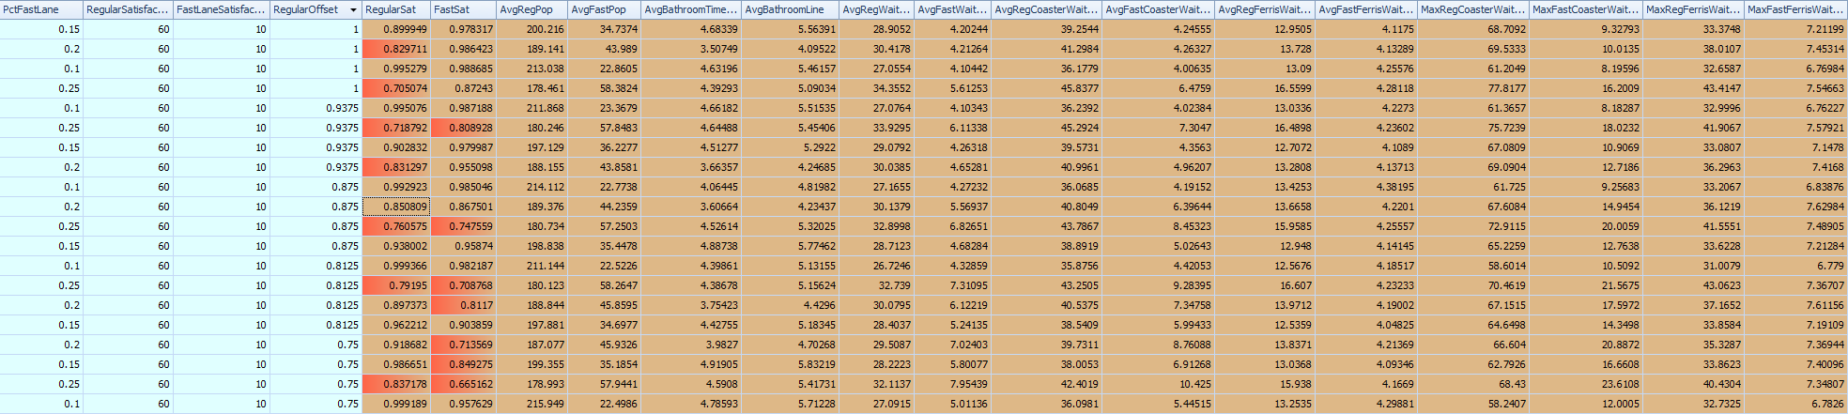
How powerful should the Fast Pass be?

